Slide 1


Oscillations

Slide 2
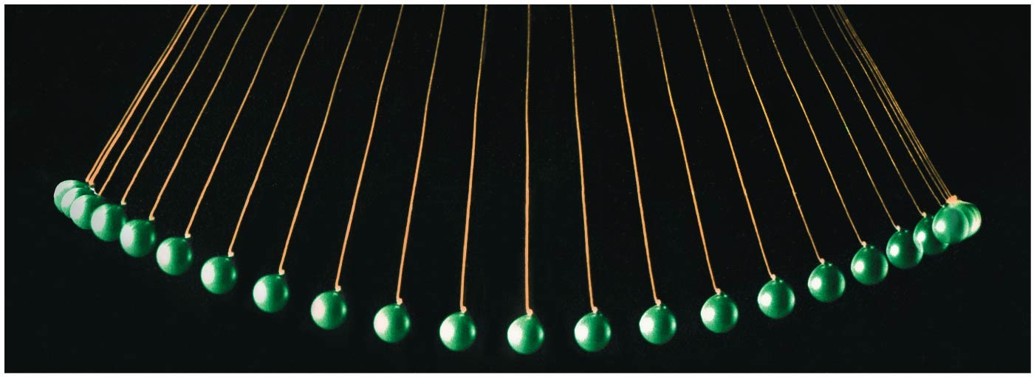
Oscillations
IN THIS CHAPTER, you will learn about systems that oscillate in simple harmonic motion.

Slide 3
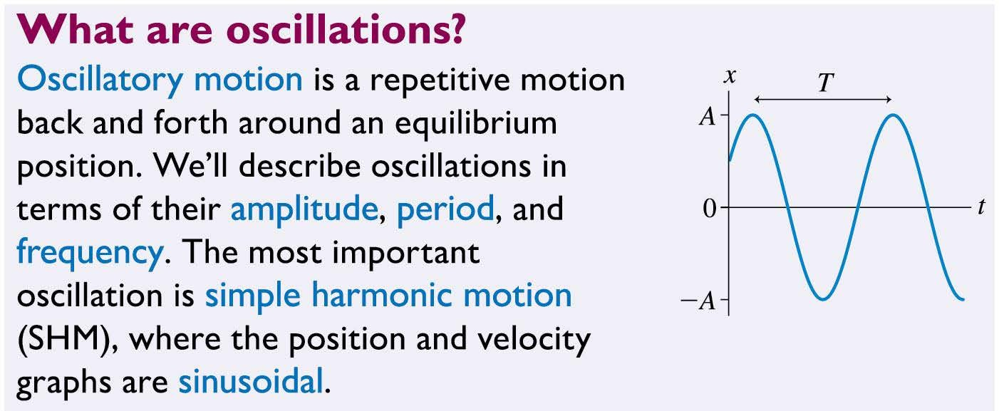

Slide 4
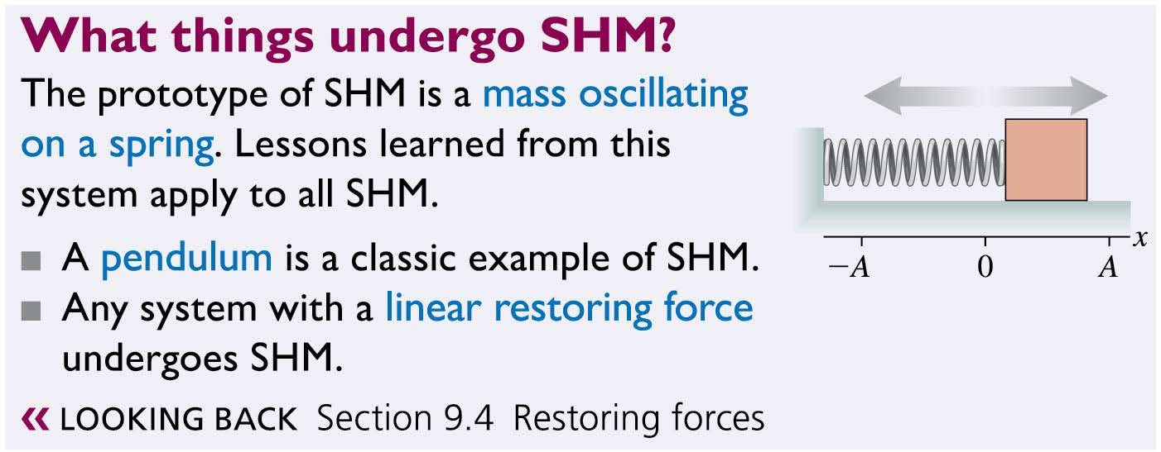

Slide 5
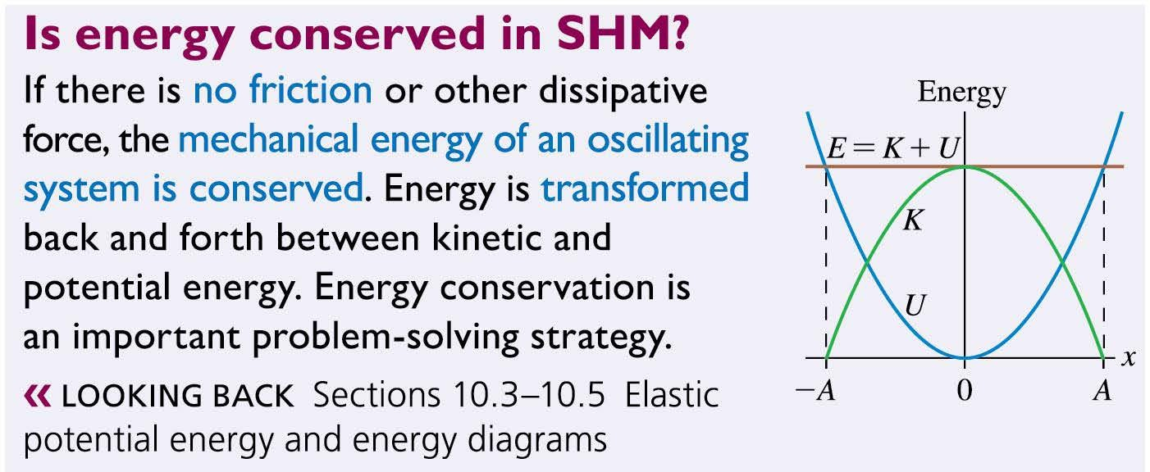
Chapter 15 Preview

Slide 6
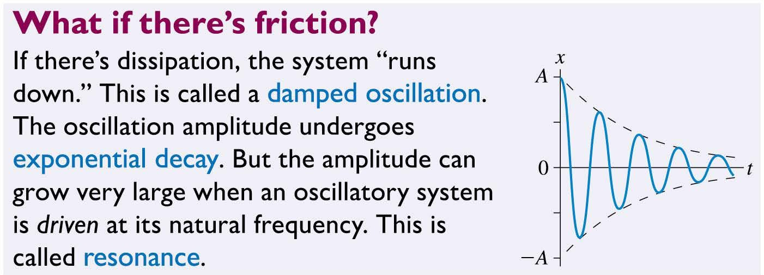

Slide 7
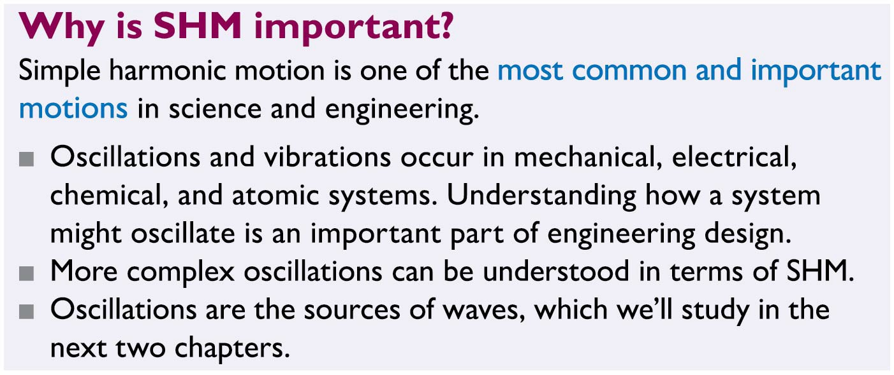
Chapter 15 Preview

Slide 8
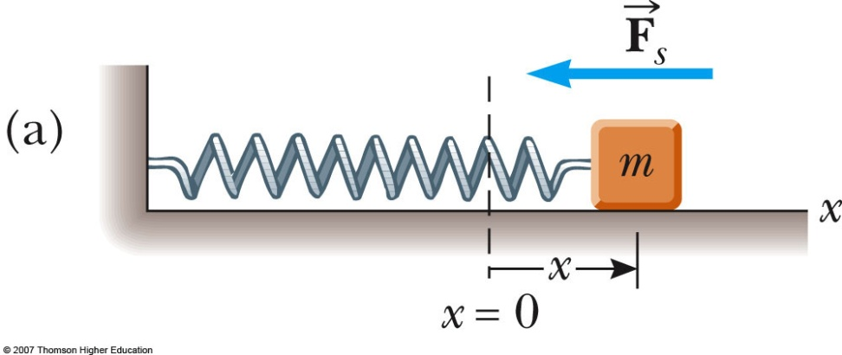
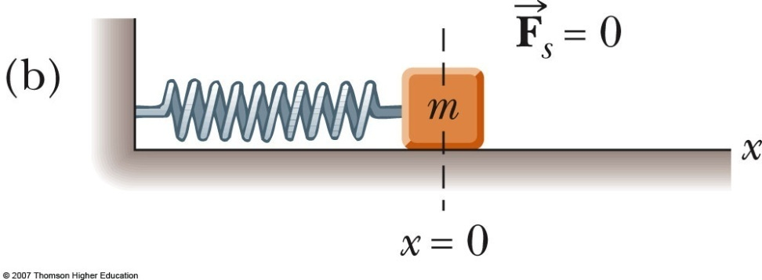
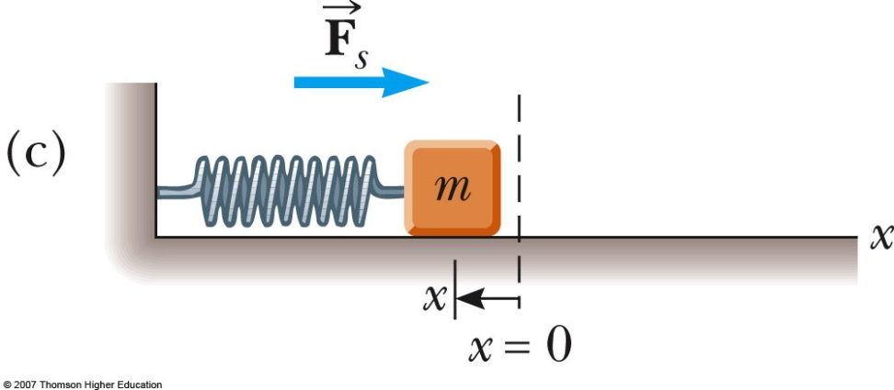
15.1:Motion of an object attached to a spring
A block of mass m is attached to a spring, the block is free to move on a frictionless horizontal surface. When the spring is neither stretched nor compressed, the block is at the equilibrium position x = 0
(a) The block is displaced to the right distance x = x_{m} and released. The spring is stretched and the restoring force is directed to the left. The phase constant is 0.
(b) The block is passing the equilibrium position, x = 0. The velocity has maximum value .
(c) The block after reaching a position x = -x_{m} is moving to the right. The spring is compressed and the restoring force is directed to the right.

Slide 9
15.1: Motion of an object attached to a spring
Hooke’s Law states F_{s} = - kx
F_{s} is the restoring force
It is always directed toward the equilibrium position
Therefore, it is always opposite the displacement from equilibrium
k is the force (spring) constant
x is the displacement

Slide 10
Acceleration
The force described by Hooke’s Law is the net force in Newton’s Second Law
The acceleration is not constant
Therefore, the kinematic equations cannot be applied

Slide 11
Reading Question 15.1
A “sinusoidal” function of x can be represented by
cos(x)
sin(x)
tan(x)
Either A or B.
Either A, B or C.

Slide 12
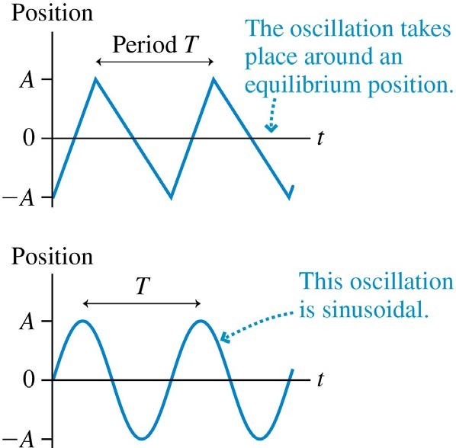
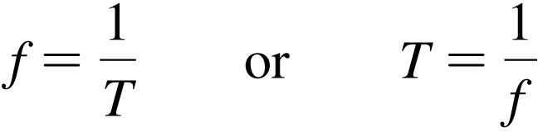
Oscillatory Motion
Objects that undergo a repetitive motion back and forth around an equilibrium position are called oscillators.
The time to complete one full cycle, or one oscillation, is called the period T.
The number of cycles per second is called the frequency
f, measured in Hz:
1 Hz = 1 cycle per second = 1 s^{–1}

Slide 13
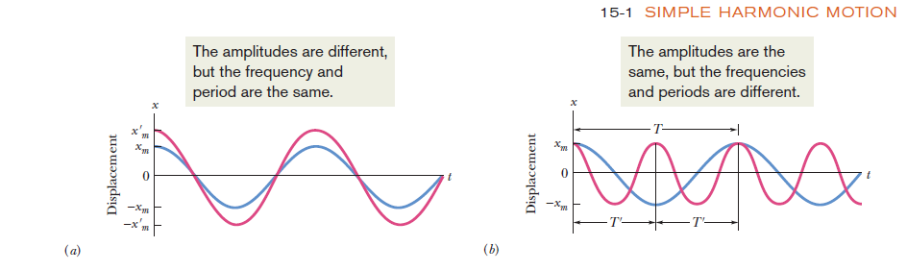

Slide 14
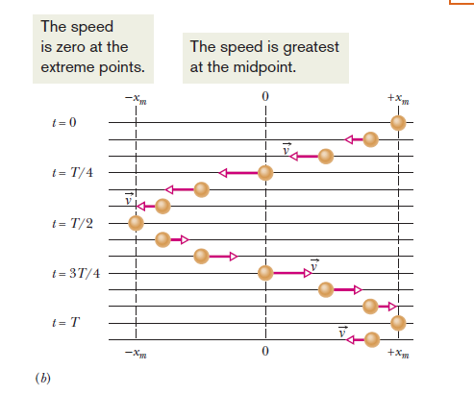

Slide 15
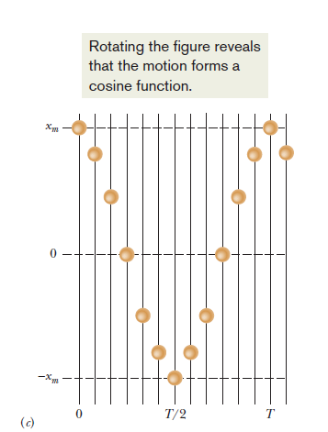
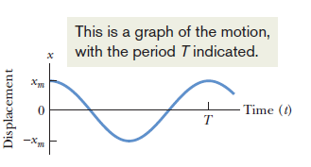

Slide 16
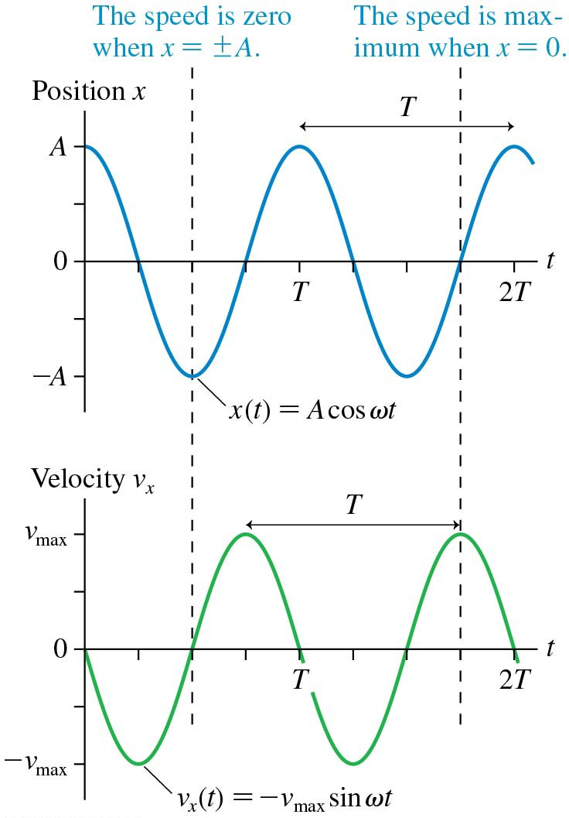
Simple Harmonic Motion
The top image shows position versus time for an object undergoing simple harmonic motion.
The bottom image shows the velocity versus time graph for the same object.
The velocity is zero at the times when x = ± A; these are the turning points of the motion.
The maximum speed v_{max} is reached at the times when x = 0.

Slide 17
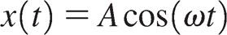
Simple Harmonic Motion
If the object is released from rest at time t = 0, we can model the motion with the cosine function:
Cosine is a sinusoidal function.
ω is called the angular frequency, defined as
ω = 2π/T
The units of ω are rad/s:
ω = 2πf

Slide 18
Simple Harmonic Motion
The position of the oscillator is
Using the derivative of the position function, we find the velocity:
The maximum speed is
v_{max} = ωA

Slide 19
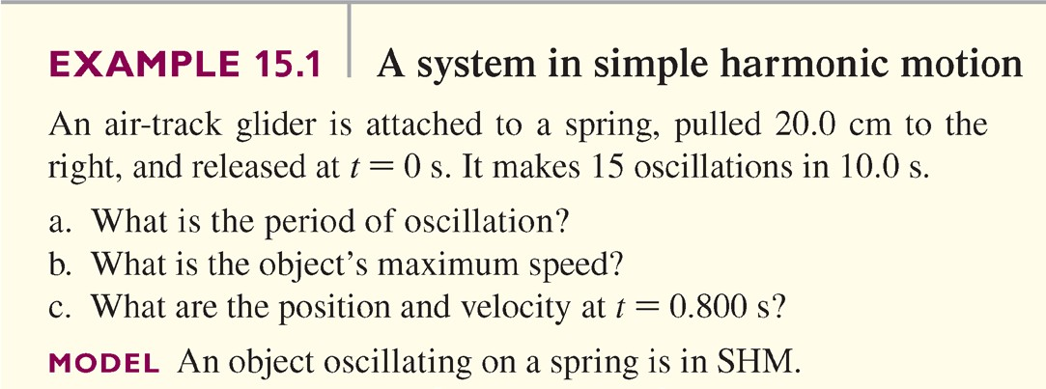
A System in Simple Harmonic Motion

Slide 20

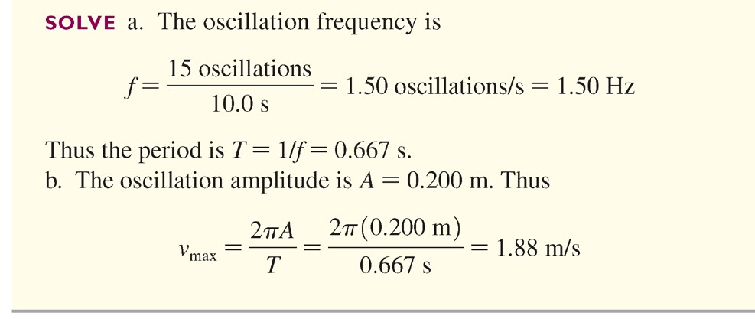
Example 15.1 A System in Simple Harmonic Motion

Slide 21
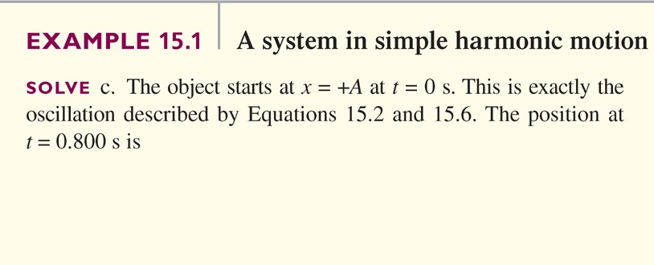
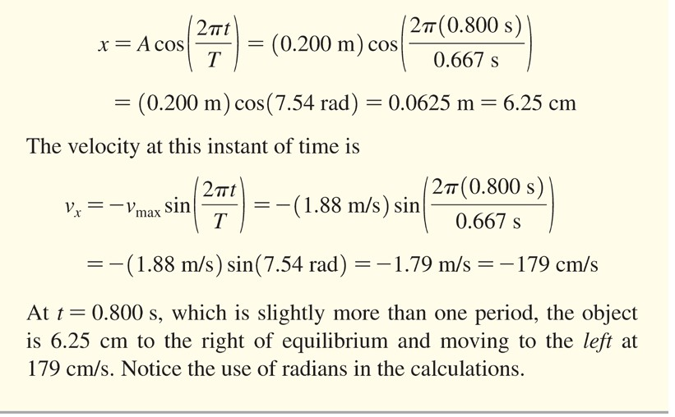
A System in Simple Harmonic Motion

Slide 22
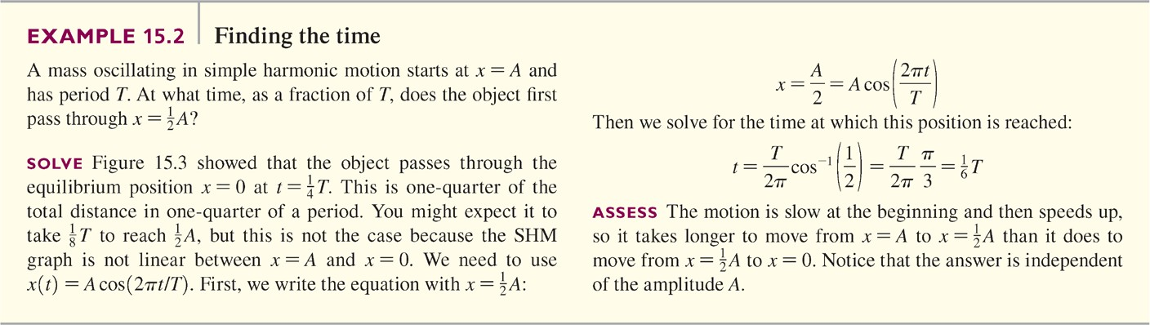
Finding the Time

Slide 23
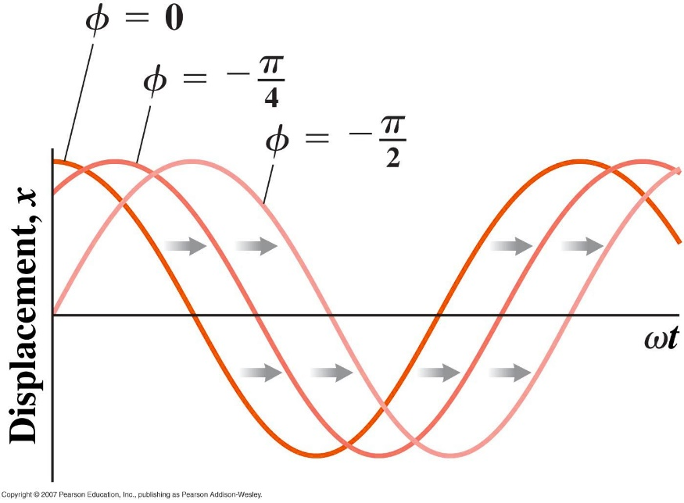
Simple Harmonic Motion (Phase) Phase
.
It is easy to show that
is a more general solution of the equation of motion.
The symbol φ is called the phase. It defines the
initial displacement
x = A cosφ

Slide 24
Simple Harmonic Motion, cont
φ is determined uniquely by the position of the particle at t = 0
If the particle is at x = A at t = 0, then φ = 0
The phase of the motion is the quantity (ωt + φ)

Slide 25
Simple Harmonic Motion Position, Velocity, Acceleration
Position
Velocity
Acceleration

Slide 26
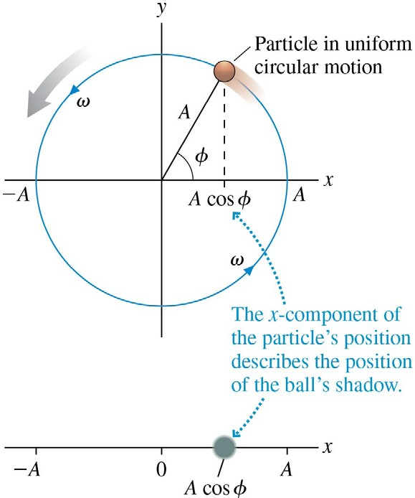
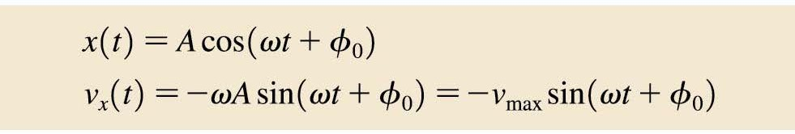
The Phase Constant
What if an object in SHM is not initially at rest at x = A when t = 0?
Then we may still use the cosine function, but with a phase constant measured in radians.
In this case, the two primary kinematic equations of SHM are:

Slide 27
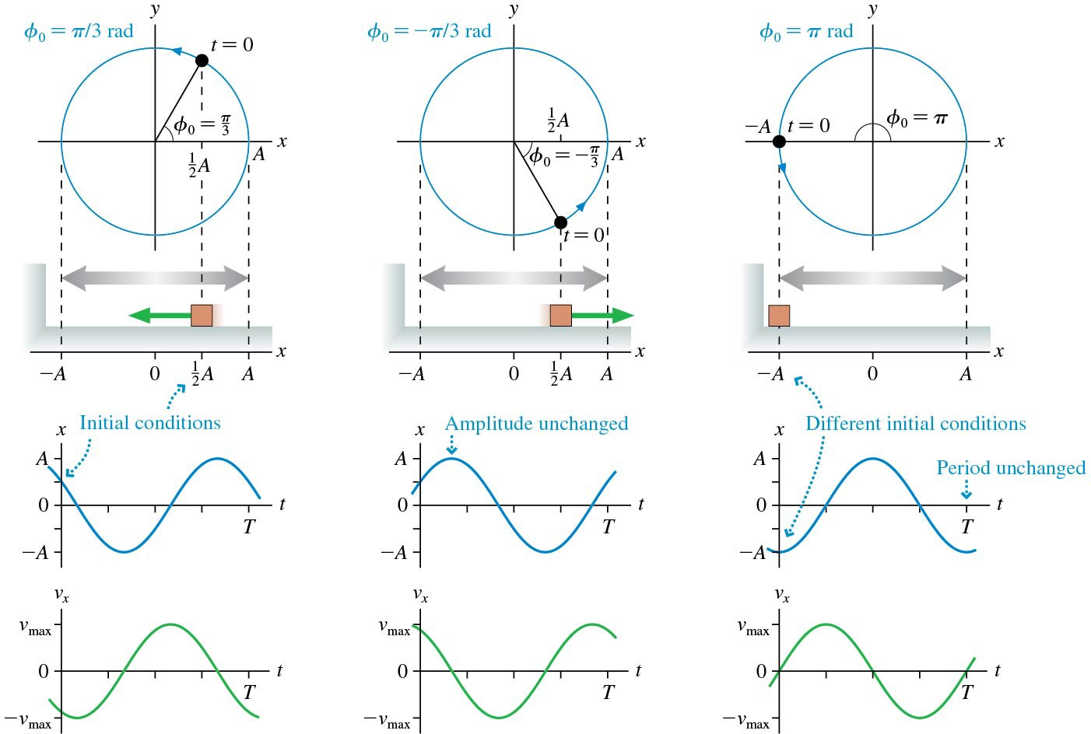
The Phase Constant
Oscillations described by different values of the phase constant.

Slide 28
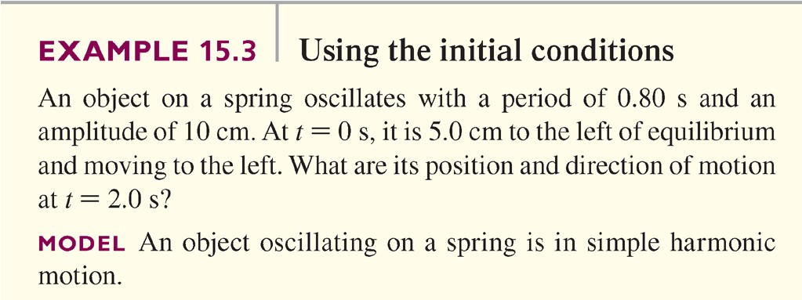
Example 15.3 Using the Initial Conditions

Slide 29

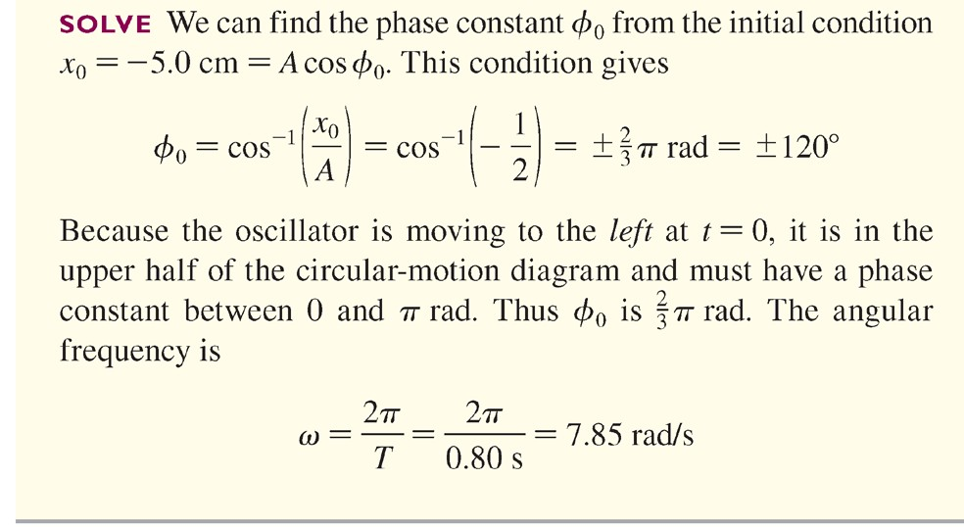
Example 15.3 Using the Initial Conditions

Slide 30


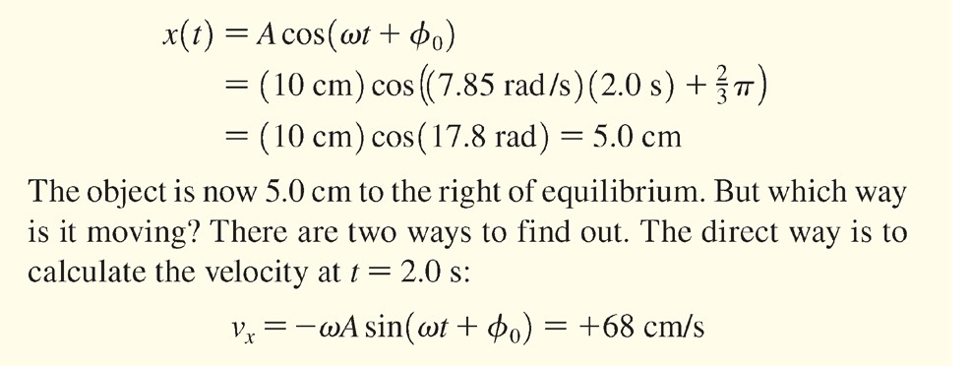
Example 15.3 Using the Initial Conditions

Slide 31
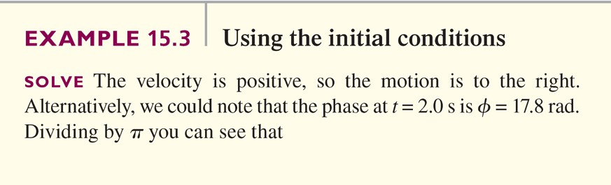
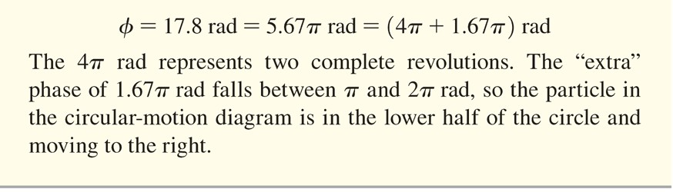
Example 15.3 Using the Initial Conditions

Slide 32
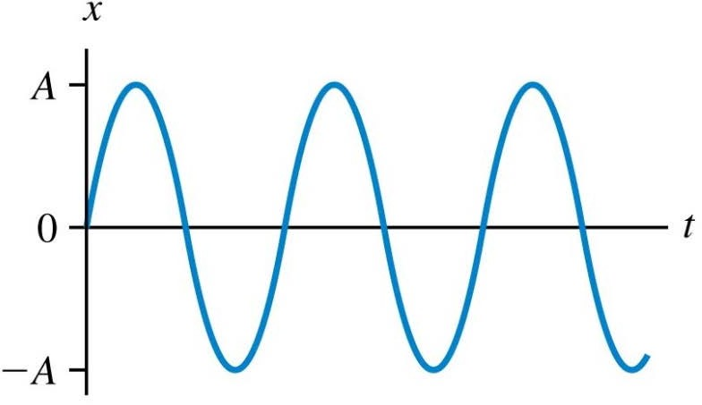
QuickCheck 15.2
This is the position graph of a mass oscillating on a horizontal spring. What is the phase constant ϕ₀?
–π/2 rad
0 rad
π/2 rad
π rad
None of these

Slide 33
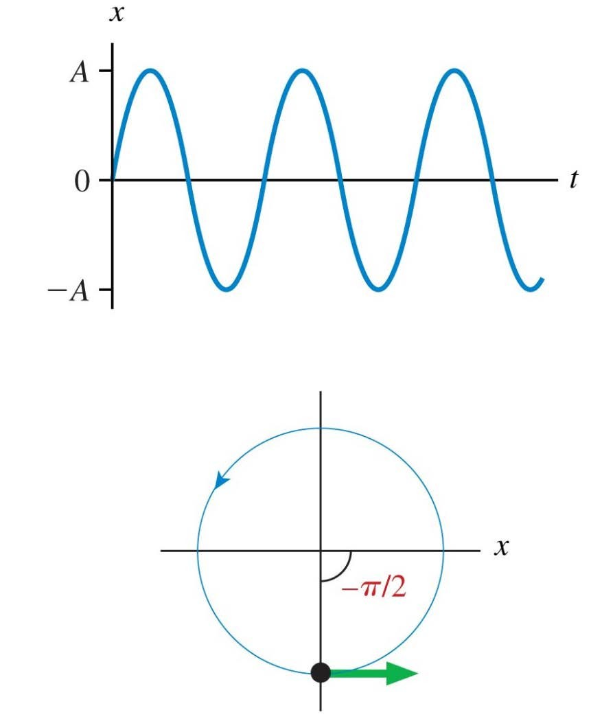

QuickCheck 15.2
This is the position graph of a mass oscillating on a horizontal spring. What is the phase constant ϕ₀?
–π/2 rad
0 rad
π/2 rad
π rad
None of these
Initial conditions:
x = 0
v_{x} > 0

Slide 34
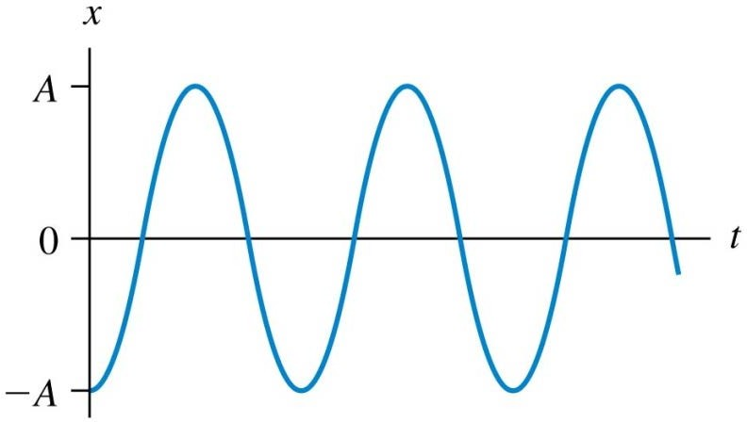
QuickCheck 15.3
This is the position graph of a mass oscillating on a horizontal spring. What is the phase constant ϕ₀?
–π /2 rad
0 rad
π /2 rad
π rad
None of these

Slide 35
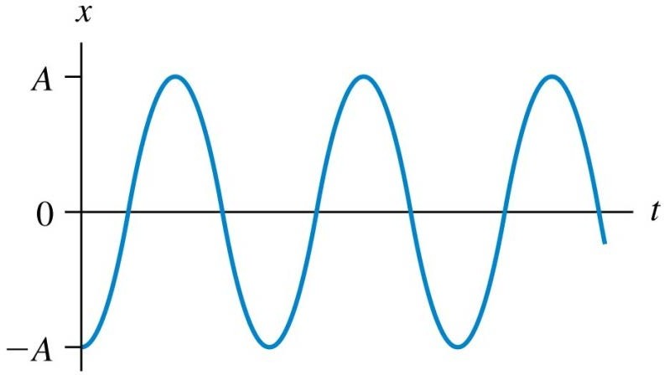
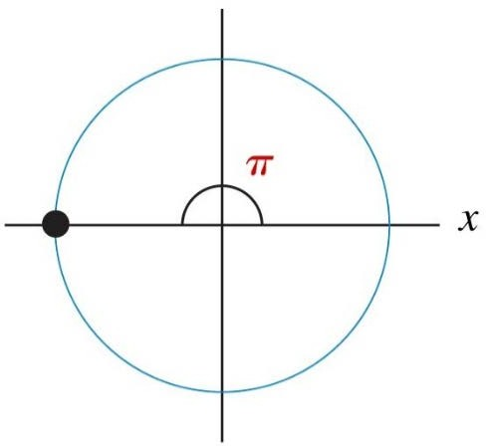
QuickCheck 15.3
This is the position graph of a mass oscillating on a horizontal spring. What is the phase constant ϕ₀?
–π /2 rad
0 rad
π /2 rad
π rad
None of these
Initial conditions:
x = –A
v_{x} = 0

Slide 36
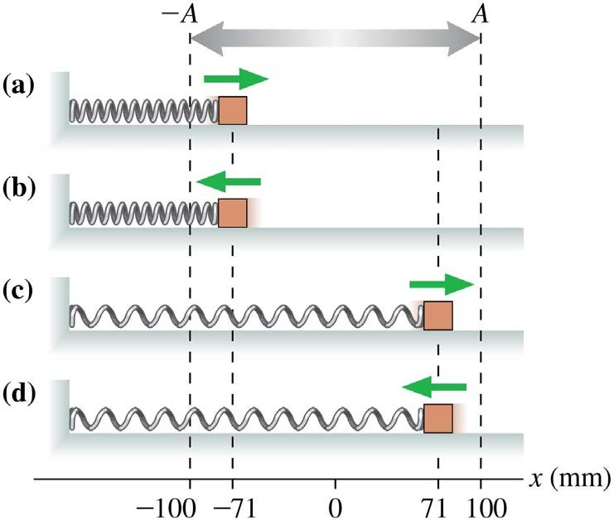
QuickCheck 15.4
The figure shows four oscillators at t = 0. For which is the phase constant ϕ₀ =–π /4?

Slide 37
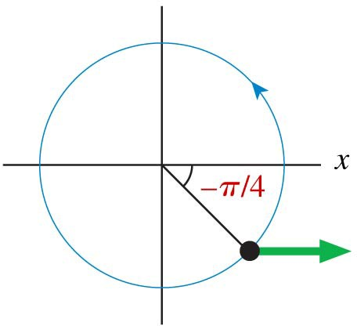
QuickCheck 15.4
The figure shows four oscillators at t = 0. For which is the phase constant ϕ₀ =–π /4?
Initial conditions:
x = 0.71A
v_{x} > 0

Slide 38
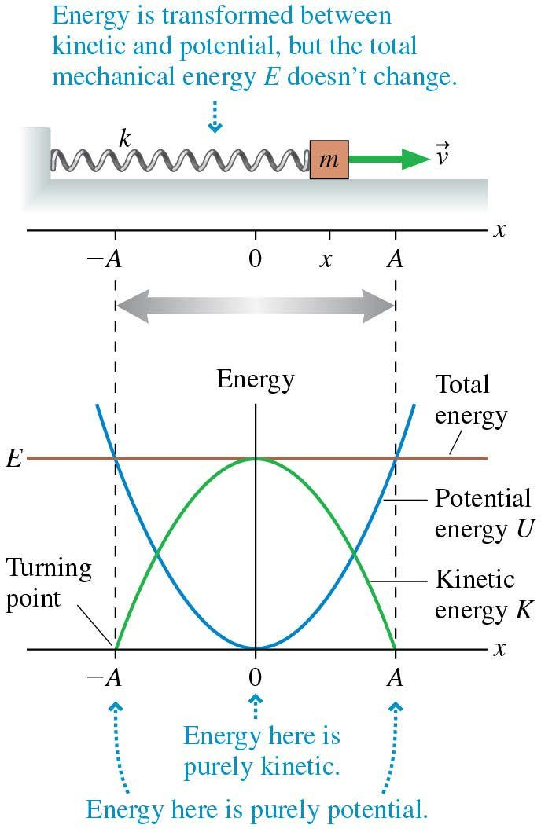
Energy in Simple Harmonic Motion
An object of mass m on a frictionless horizontal surface is attached to one end of a spring of spring constant k.
The other end of the spring is attached to a fixed wall.
As the object oscillates, the energy is transformed
between kinetic energy and
potential energy, but the mechanical energy E = K + U doesn’t change.

Slide 39
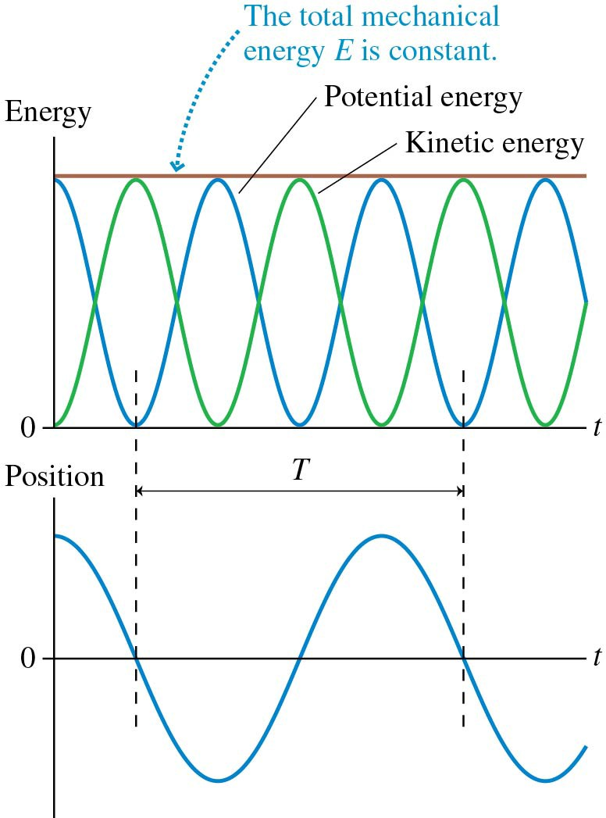
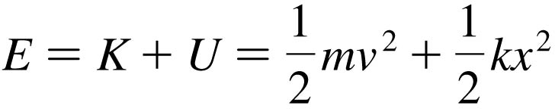
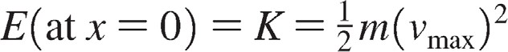
Energy in Simple Harmonic Motion
Energy is conserved in Simple Harmonic Motion:

Slide 40
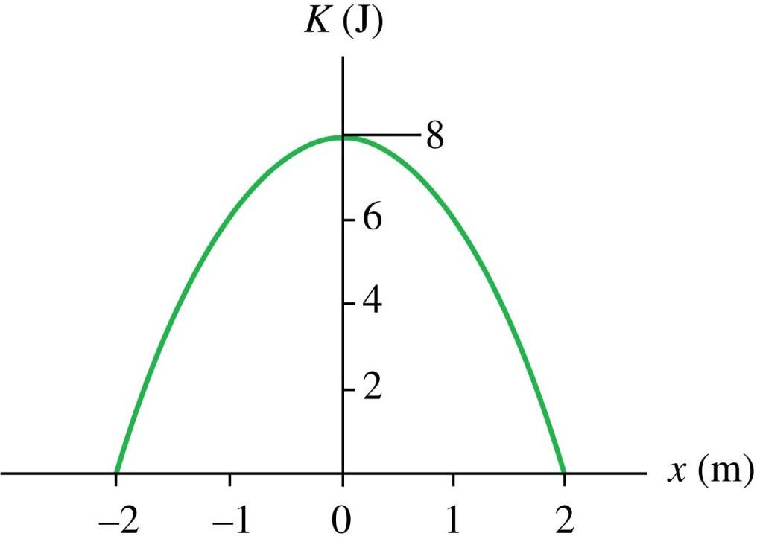
QuickCheck 15.5
A block oscillates on a very long horizontal spring. The graph shows the block’s kinetic energy as a function of position. What is the spring constant?
1 N/m
2 N/m
4 N/m
8 N/m
I have no idea.

Slide 41
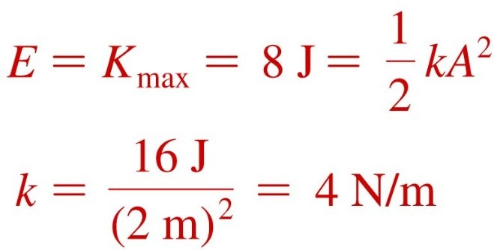
QuickCheck 15.5
A block oscillates on a very long horizontal spring. The graph shows the block’s kinetic energy as a function of position. What is the spring constant?
1 N/m
2 N/m
4 N/m
8 N/m
I have no idea.

Slide 42
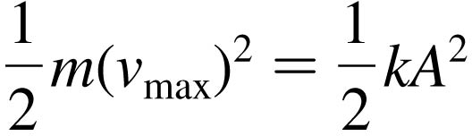
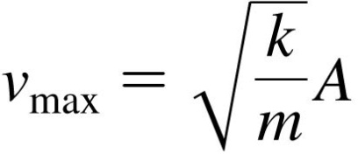
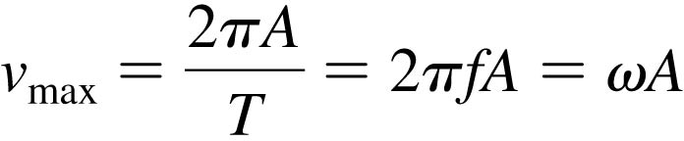
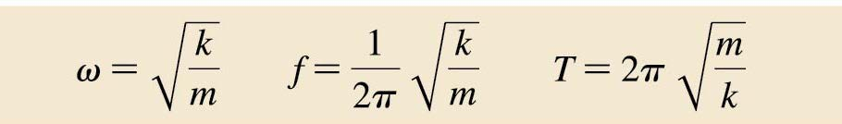
Frequency of Simple Harmonic Motion
In SHM, when K is maximum, U = 0, and when U is maximum, K = 0.
K + U is constant, so K_{max} = U_{max}:
So
Earlier, using kinematics, we found that
So

Slide 43
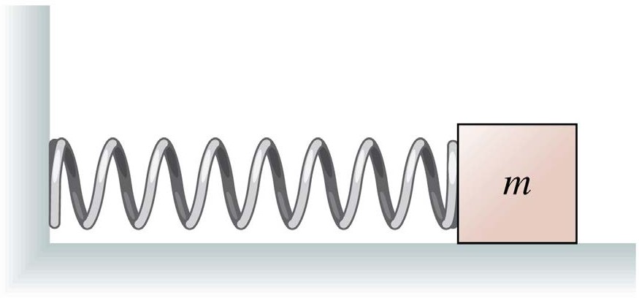
QuickCheck 15.6
A mass oscillates on a horizontal spring with period T = 2.0 s. If the amplitude of the oscillation is doubled, the new period will be
1.0 s
1.4 s
2.0 s
2.8 s
4.0 s

Slide 44
QuickCheck 15.6
A mass oscillates on a horizontal spring with period T = 2.0 s. If the amplitude of the oscillation is doubled, the new period will be
1.0 s
1.4 s
2.0 s
2.8 s
4.0 s

Slide 45
QuickCheck 15.7
A block of mass m oscillates on a horizontal spring with period T = 2.0 s. If a second identical block is glued to the top of the first block, the new period will be
1.0 s
1.4 s
2.0 s
2.8 s
4.0 s

Slide 46
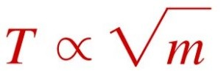
QuickCheck 15.7
A block of mass m oscillates on a horizontal spring with period T = 2.0 s. If a second identical block is glued to the top of the first block, the new period will be
1.0 s
1.4 s
2.0 s
2.8 s
4.0 s

Slide 47

QuickCheck 15.8
Two identical blocks oscillate on different horizontal springs. Which spring has the larger spring constant?
The red spring
The blue spring
There’s not enough information to tell.

Slide 48

QuickCheck 15.8
Two identical blocks oscillate on different horizontal springs. Which spring has the larger spring constant?
The red spring
The blue spring
There’s not enough information to tell.

Slide 49

Example 15.4 Using Conservation of Energy

Slide 50



Example 15.4 Using Conservation of Energy

Slide 51


Example 15.4 Using Conservation of Energy

Slide 52

Simple Harmonic Motion Motion Diagram
The top set of dots is a motion diagram for SHM going to the right.
The bottom set of dots is a motion diagram for SHM going to the left.
At x = 0, the object’s speed is as large as possible, but it is not changing; hence acceleration is zero at x = 0.

Slide 53



Acceleration in Simple Harmonic Motion
Acceleration is the time- derivative of the velocity:
In SHM, the acceleration is proportional to the negative of the displacement.

Slide 54




Dynamics of Simple Harmonic Motion
Consider a mass m oscillating on a horizontal spring with no friction.
The spring force is
Since the spring force is the net force, Newton’s second law gives
Since a_{x} = –ω²x, the angular frequency must
.
be

Slide 55

QuickCheck 15.9
A mass oscillates on a horizontal spring. It’s velocity is v_{x} and the spring exerts force F_{x}. At the time indicated by the arrow,
v_{x} is + and F_{x} is +.
v_{x} is + and F_{x} is –.
v_{x} is – and F_{x} is 0.
v_{x} is 0 and F_{x} is +.
v_{x} is 0 and F_{x} is –.

Slide 56
QuickCheck 15.9
A mass oscillates on a horizontal spring. It’s velocity is v_{x} and the spring exerts force F_{x}. At the time indicated by the arrow,
v_{x} is + and F_{x} is +.
v_{x} is + and F_{x} is –.
v_{x} is – and F_{x} is 0.
v_{x} is 0 and F_{x} is +.
v_{x} is 0 and F_{x} is –.

Slide 57

QuickCheck 15.10
A mass oscillates on a horizontal spring. It’s velocity is v_{x} and the spring exerts force F_{x}. At the time indicated by the arrow,
v_{x} is + and F_{x} is +.
v_{x} is + and F_{x} is –.
v_{x} is – and F_{x} is 0.
v_{x} is 0 and F_{x} is +.
v_{x} is 0 and F_{x} is –.

Slide 58
QuickCheck 15.10
A mass oscillates on a horizontal spring. It’s velocity is v_{x} and the spring exerts force F_{x}. At the time indicated by the arrow,
v_{x} is + and F_{x} is +.
v_{x} is + and F_{x} is –.
v_{x} is – and F_{x} is 0.
v_{x} is 0 and F_{x} is +.
v_{x} is 0 and F_{x} is –.

Slide 59


Vertical Oscillations
Motion for a mass hanging from a spring is the same as for horizontal SHM,
but the equilibrium position is affected.

Slide 60


Example 15.6 Bungee Oscillations

Slide 61


Example 15.6 Bungee Oscillations

Slide 62





Example 15.6 Bungee Oscillations

Slide 63

QuickCheck 15.11
A block oscillates on a vertical spring. When the block is at the lowest point of the oscillation, it’s acceleration a_{y} is
Negative.
Zero.
Positive.

Slide 64

QuickCheck 15.11
A block oscillates on a vertical spring. When the block is at the lowest point of the oscillation, it’s acceleration a_{y} is
Negative.
Zero.
Positive.

Slide 65


The Simple Pendulum
Consider a mass m attached to a string of length L which is free to swing back and forth.
If it is displaced from its lowest position by an angle θ, Newton’s second law for the tangential component of gravity, parallel
to the motion, is

Slide 66


The Simple Pendulum
If we restrict the pendulum’s oscillations to small angles (< 10º), then we may use the small angle approximation sin θ ≈ θ, where θ is measured in radians.
and the angular frequency of the motion is found to be

Slide 67

Example 15.7 The Maximum Angle of a Pendulum

Slide 68



Example 15.7 The Maximum Angle of a Pendulum

Slide 69

QuickCheck 15.12
A ball on a massless, rigid rod oscillates as a simple pendulum with a period of 2.0 s. If the ball is replaced with another ball having twice the mass, the period will be
1.0 s
1.4 s
2.0 s
2.8 s
4.0 s

Slide 70
QuickCheck 15.12
A ball on a massless, rigid rod oscillates as a simple pendulum with a period of 2.0 s. If the ball is replaced with another ball having twice the mass, the period will be
1.0 s
1.4 s
2.0 s
2.8 s
4.0 s

Slide 71
QuickCheck 15.13
On Planet X, a ball on a massless, rigid rod oscillates as a simple pendulum with a period of 2.0 s. If the pendulum is taken to the moon of Planet X, where the free-fall acceleration g is half as big, the period will be
1.0 s
1.4 s
2.0 s
2.8 s
4.0 s

Slide 72

QuickCheck 15.13
On Planet X, a ball on a massless, rigid rod oscillates as a simple pendulum with a period of 2.0 s. If the pendulum is taken to the moon of Planet X, where the free-fall acceleration g is half as big, the period will be
1.0 s
1.4 s
2.0 s
2.8 s
4.0 s

Slide 73

The Simple-Harmonic-Motion Model

Slide 74

Example 15.9 A Swinging Leg as a Pendulum

Slide 75



Example 15.9 A Swinging Leg as a Pendulum

Slide 76

Example 15.9 A Swinging Leg as a Pendulum

Slide 77

QuickCheck 15.14
A solid disk and a circular hoop have the same radius and the same mass. Each can swing back and forth as a pendulum from a pivot at one edge. Which has the larger period of oscillation?
The solid disk
The circular hoop
Both have the same period.
There’s not enough information to tell.

Slide 78

QuickCheck 15.14
A solid disk and a circular hoop have the same radius and the same mass. Each can swing back and forth as a pendulum from a pivot at one edge. Which has the larger period of oscillation?
The solid disk
The circular hoop
Both have the same period.
There’s not enough information to tell.

Slide 79
Damped Oscillations
A pendulum left to itself gradually slows down and stops. The sound of a ringing bell gradually dies away.
All real oscillators do run down—some very slowly but others quite quickly—as friction or other dissipative forces transform their mechanical energy
into the thermal energy of the oscillator and its environment.

Slide 80
Damped Oscillations
An oscillation that runs down and stops is called a damped oscillation.
There are many possible reasons for the dissipation of energy, such as air resistance, friction, and internal forces within a metal spring as it flexes.
The forces involved in dissipation are complex, but a simple
linear drag model is
A drag force that depends linearly on the velocity.
where the minus sign is the mathematical statement that the force is always opposite in direction to the velocity in order to slow the object

Slide 81
Damping constant b
The damping constant b depends in a complicated way on the shape of the object and on the viscosity of the air or other medium in which the particle moves.
The units of b need to be such that they will give units of force when multiplied by units of velocity.

Slide 82


A mass oscillating on a spring in the presence of a drag force. With the drag included, Newton’s second law is

Slide 83



Damped Oscillations
The solution of this second order differential equation is
where the angular frequency is given by
Here is the angular frequency of the undamped oscillator (b = 0).

Slide 84

Damped Oscillations
Position-versus-time graph for a damped oscillator.
Notice that the term Ae^{-bt/2m}, which is shown by the dashed line

Slide 85


Damped Oscillations
A damped oscillator has position x = x_{max}cos(ωt + ϕ₀), where
This slowly changing function x_{max} provides a border to the rapid oscillations, and is called the envelope.
The figure shows several oscillation envelopes, corresponding to different values of the damping constant b.

Slide 86

Driven Oscillations and Resonance
Consider an oscillating system that, when left to itself, oscillates at a natural frequency f₀.
Suppose that this system is subjected to a periodic
external force of driving frequency f_{ext}.
The amplitude of oscillations is generally not very high if f_{ext} differs much from f₀.
As f_{ext} gets closer and closer to f₀, the amplitude of the oscillation rises dramatically.
A singer or musical instrument can shatter a crystal goblet by matching the goblet’s natural oscillation frequency.

Slide 87

Driven Oscillations and Resonance
The response curve shows the amplitude of a driven oscillator at frequencies near its natural frequency of
2.0 Hz.

Slide 88

Driven Oscillations and Resonance
The figure shows the same oscillator with three different values
of the damping constant.
The resonance amplitude becomes higher and narrower as the damping constant decreases.

Slide 89

QuickCheck 15.15
The graph shows how three oscillators respond as the frequency of a driving force is varied. If each oscillator is started and then left alone, which will oscillate for the longest time?
The red oscillator
The blue oscillator
The green oscillator
They all oscillate for
the same length of time.

Slide 90


QuickCheck 15.15
The graph shows how three oscillators respond as the frequency of a driving force is varied. If each oscillator is started and then left alone, which will oscillate for the longest time?
The red oscillator
The blue oscillator
The green oscillator
They all oscillate for
the same length of time.

Slide 91
Chapter 15 Summary Slides

Slide 92

General Principles

Slide 93

General Principles

Slide 94

Important Concepts

Slide 95

Important Concepts

Slide 96

Applications

Slide 97

Applications

